Slide 1
Cryptography and
Computer Security
Instructor: Dr. Waleed Khalid

Slide 2
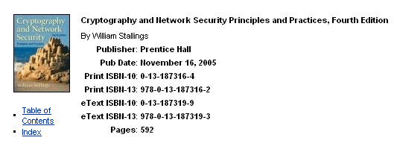
Main Textbook

Slide 3
Some Terminology
Vulnerability, Threat and Attack
Vulnerability:
A weak point in the system which may be exploited by an attacker
Threat :
A potential for violation of security, which exists when there is a circumstance, capability, action, or event that could breach security and cause harm. That is, a threat is a possible danger that might exploit a vulnerability.
Attack:
An assault on system security that derives from an intelligent threat; that is, an intelligent act that is a deliberate attempt (especially in the sense of a method or technique) to evade security services and violate the security policy of a system.

Slide 4
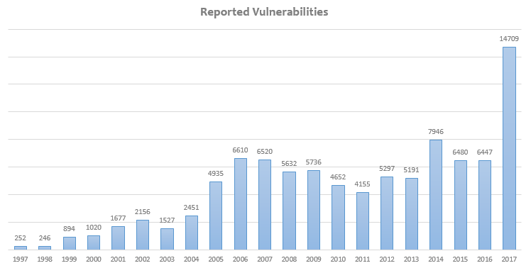
Yearly Reports of Vulnerabilities
https://www.welivesecurity.com/2018/02/05/vulnerabilities-reached-historic-peak-2017/

Slide 5
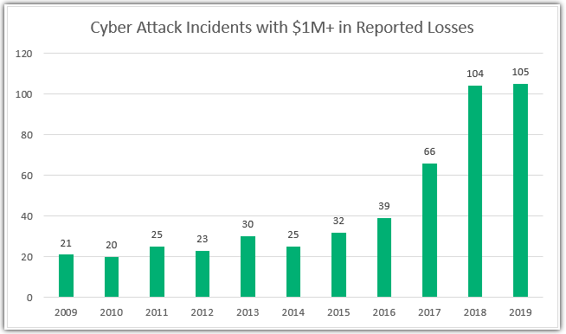
Yearly Reports of Attack Incidents
https://sectigostore.com/blog/42-cyber-attack-statistics-by-year-a-look-at-the-last-decade/

Slide 6


Security Layers
Perimeter
layer
network
layer
OS layer
DB layer
Remote
client
Server Operating System
DBServer
Remote
client
internet
firewall
application
Storage
Local
user
Local Net.
application
layer

Slide 7
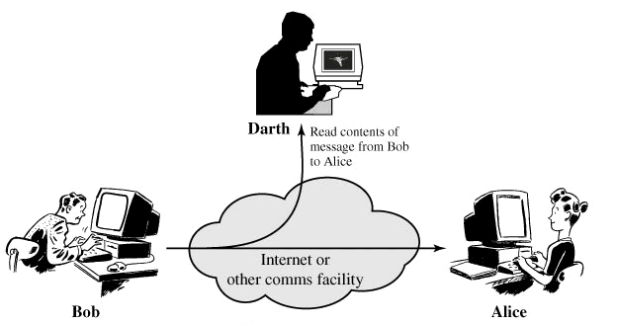
Attack Models
1- Interception
(Releasing message Contents & Traffic Analysis)

Slide 8
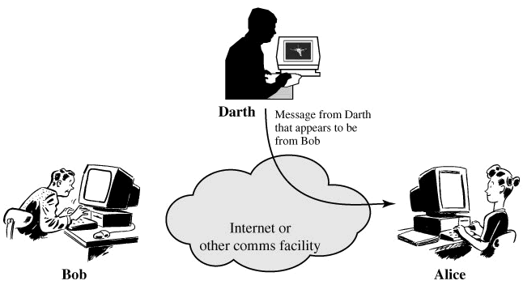
Attack Models
2- Masquerading : also called, spoofing, fabrication, or impersonation

Slide 9

Attack Models
3- Replay (and possibly modification)

Slide 10
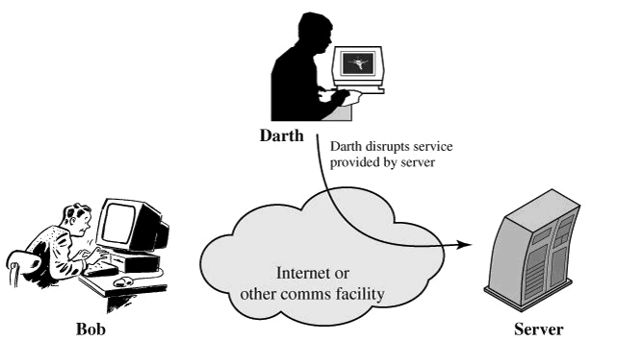
Attack Models
4- Interruption also called Denial of Service (DOS)

Slide 11
Security Services (x.800)
1- Authentication:
The assurance that the communicating entity is the one that it claims to be.
Peer Entity Authentication
Used in association with a logical connection to provide confidence in the identity of the entities connected.
Data Origin Authentication
In a connectionless transfer, provides assurance that the source of received data is as claimed.

Slide 12
Security Services
2- Access Control
The prevention of unauthorized use of a resource (i.e., this service controls who can have access to a resource, under what conditions access can occur, and what those accessing the resource are allowed to do).

Slide 13
Security Services
3- Data Confidentiality
The protection of data from unauthorized disclosure.
Connection Confidentiality
The protection of all user data on a connection.
Connectionless Confidentiality
The protection of all user data in a single data block
Selective-Field Confidentiality
The confidentiality of selected fields within the user data on a connection or in a single data block.
Traffic Flow Confidentiality
The protection of the information that might be derived from observation of traffic flows.

Slide 14
Security Services
4- Data Integrity
The assurance that data received are exactly as sent by an authorized entity (i.e., contain no modification, insertion, deletion, or replay).
Connection Integrity with Recovery
Provides for the integrity of all user data on a connection and detects any modification, insertion, deletion, or replay of any data within an entire data sequence, with recovery attempted.
Connection Integrity without Recovery
As above, but provides only detection without recovery.

Slide 15
Security Services
3- Data Integrity, continued
Selective-Field Connection Integrity
Provides for the integrity of selected fields within the user data of a data block transferred over a connection and takes the form of determination of whether the selected fields have been modified, inserted, deleted, or replayed.
Connectionless Integrity
Provides for the integrity of a single connectionless data block and may take the form of detection of data modification.
Selective-Field Connectionless Integrity
Provides for the integrity of selected fields within a single connectionless data block; whether the selected fields have been modified.

Slide 16
Security Services
5- Non-repudiation
Provides protection against denial by one of the entities involved in a communication of having participated in all or part of the communication.
Nonrepudiation, Origin
Proof that the message was sent by the specified party.
Nonrepudiation, Destination
Proof that the message was received by the specified party.

Slide 17
Security Services
6- Availability
The property of a system or a system resource being accessible and usable upon demand by an authorized system entity, according to performance specifications for the system (i.e., a system is available if it provides services according to the system design whenever users request them)

